Slide 1
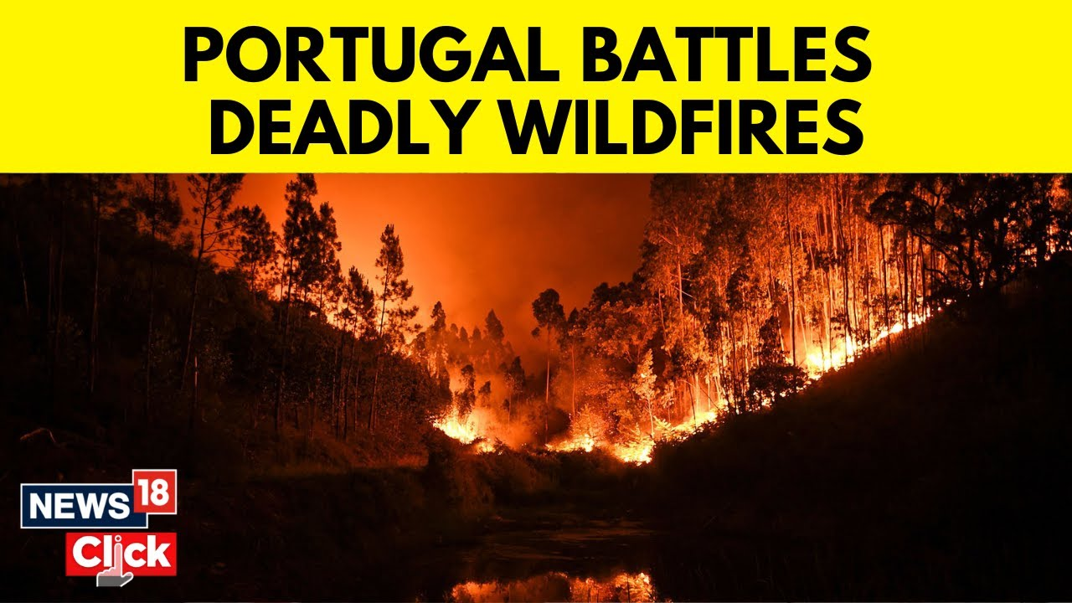
Forest fire analysis
Roya Campos
Paul Ola

Slide 2
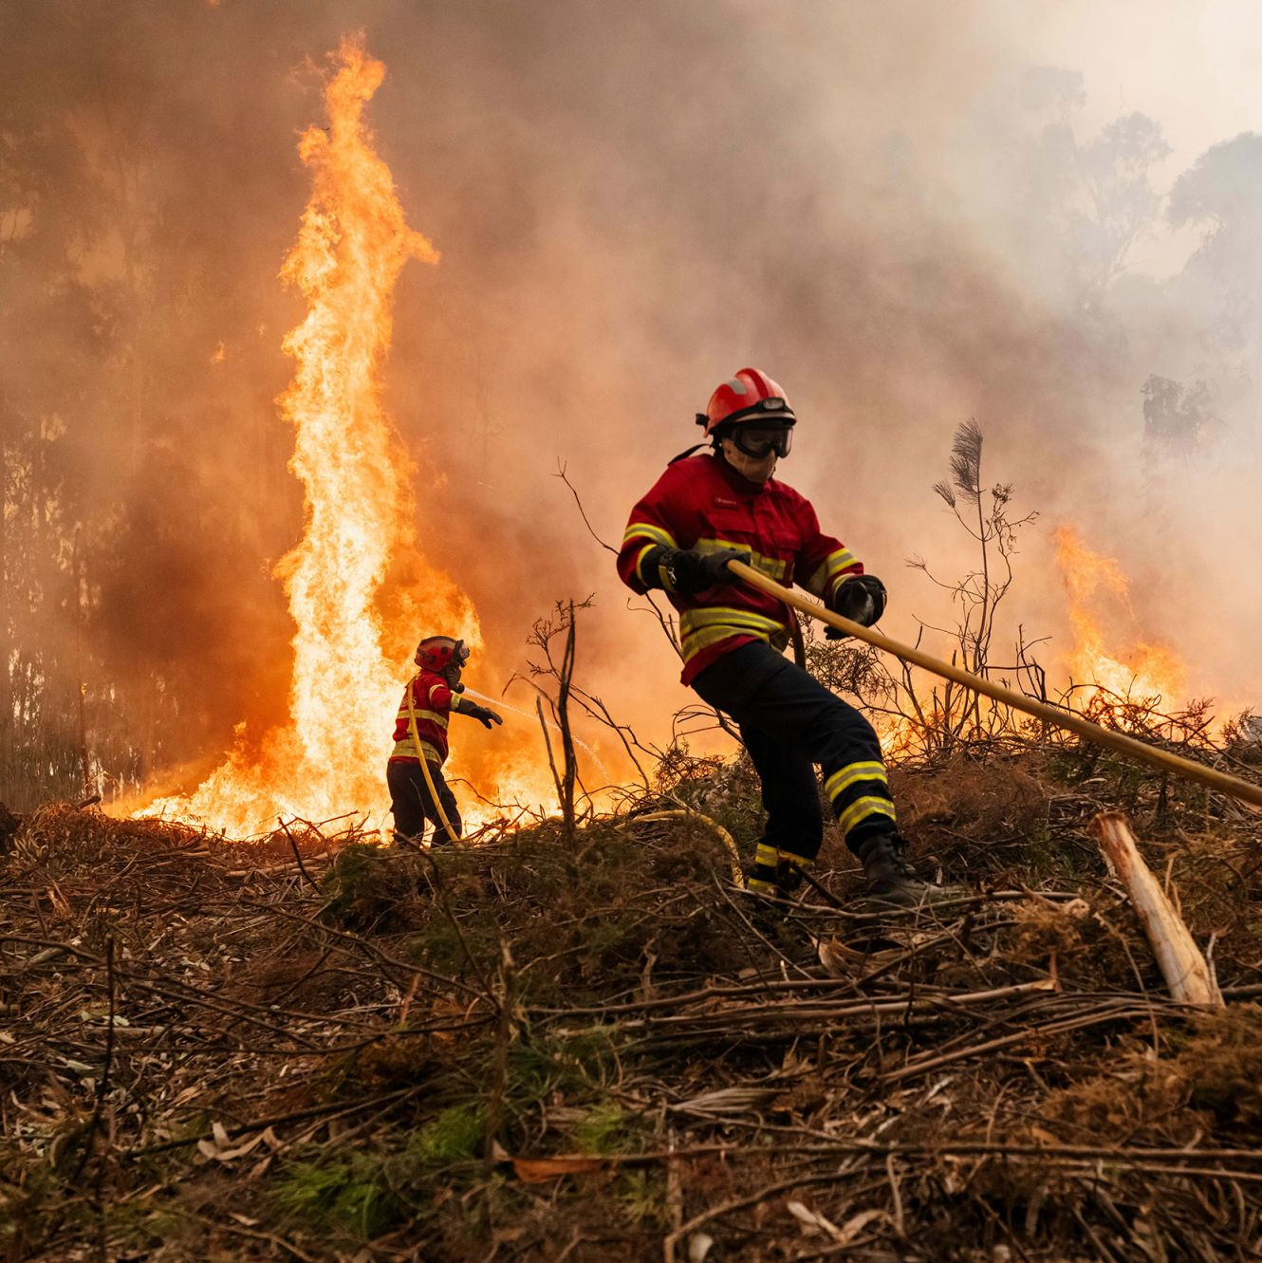
Forest Fires Dataset
Portugal experienced substantial wildfire activity: nationally, burned area peaked at ~425 726 ha in 2003, nearly quadruple the ~159 605 ha of 2000
Wildfires in this region are driven by drought in summer months, where low humidity and elevated temperatures dry fine fuels (litter, shrubs), increasing susceptibility to ignition and spread.
Source: UCI Machine Learning Repository, 2016
Location of forest fire: Montesinho Natural Park, Bragança district, Northeast Portugal
Time period of data collection: January 2000 – December 2003
Observations: 517 fire events recorded
Montesinho Natural Park, Portugal

Slide 3
Variables in dataset
Month – month of the year
Day – day of the month
FFMC (Fine fuel moisture code) - Moisture content of fine fuels (grass, leaves, small twigs).
High value – fine fuels are dry and more likely to catch fire
DMC (Duff moisture code) – moisture content of the duff (layer of decomposed organic material in the forest floor).
High value – duff layer is dry and more likely of fire spreading into duff layer
DC (Drought code) – moisture content of deeper soil and forest layers
High value – deep soil and forest floor layers are drier and more likely to sustain fires
ISI (Initial spread index) – likelihood of initial spread of a fire, based on FFMC and wind speed.
High value – fire more likely to spread fast once it starts
Temp - ambient temperature of the environment
RH – relative humidity
Wind – wind speed
Rain – outside rain
Area – the burned area of the forest

Slide 4
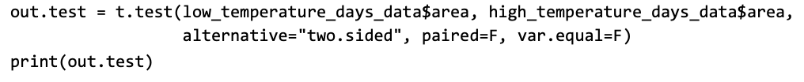
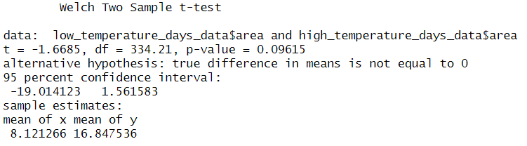
Split data into high temperature days and low temperature days and assess if there is a difference in burned area between the two groups
H1​:μlow-temp​ = μhigh-temp​
H0​:μlow-temp​ = μhigh-temp​
p-value of 0.09615
No significant difference in burned area between high temperature days and low temperature days

Slide 5


One-way ANOVA to test if mean burned area differs across any of the months
H₀: All monthly mean burned‐area values are equal. H₁: At least one month’s mean differs.
P-value is 0.993
No significant difference in burned area across all the months

Slide 6
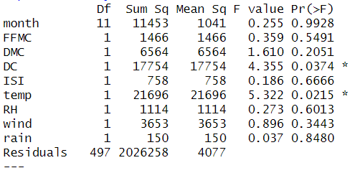
Multi-factor one-way ANOVA to test the influence of different factors on burned area
Probably can't do this because factors aren't categorical. Look into linear regression

Slide 7
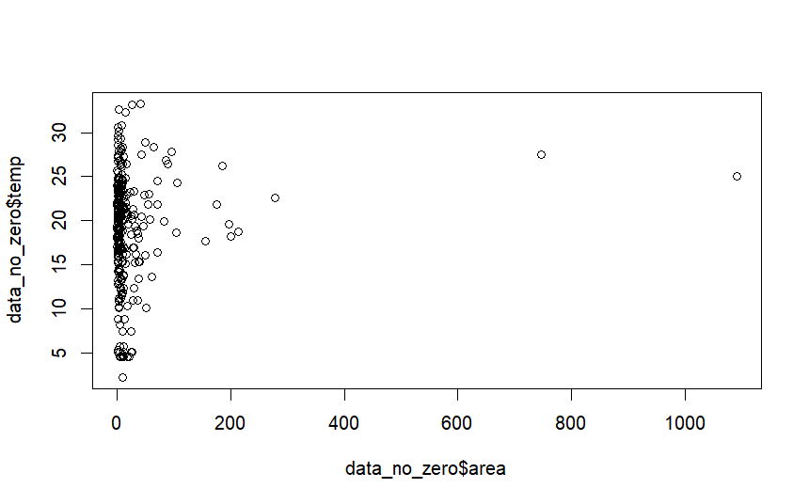
Simple linear regression of burn area against temperature
The data does not show a linear trend

Slide 8
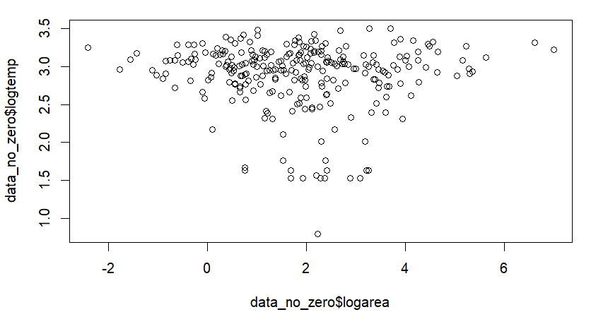
Log-transform the data since it is nonlinear
It is still not linear but we tried to run the regression model

Slide 9
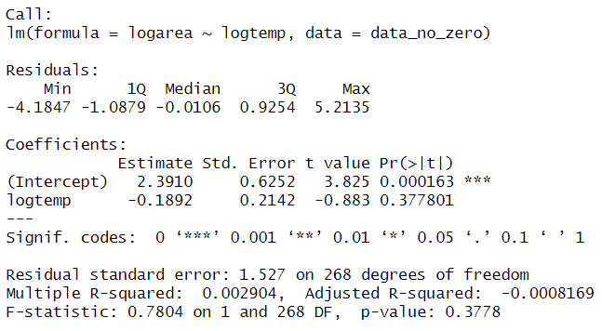
The linear regression model:
The R² seems not to be a good model and there is still no significant effect on burn area

Slide 10
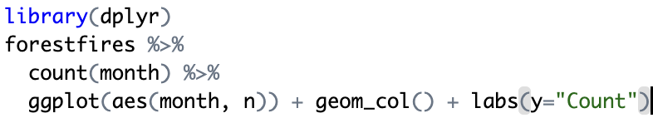
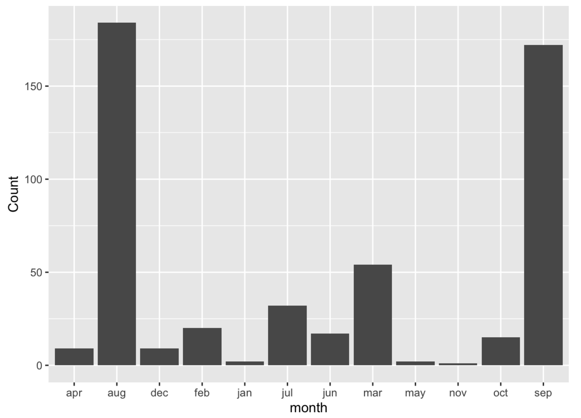
Identification of Temporal Patterns in Forest Fire Occurrences
Summarizes the number of fires per month
Determines if certain months experience higher fire activity
Importance of such analysis
Resource allocation and
Preventive measures.
The concentration of the most fires in August and September shows how Portugal’s Mediterranean‐type hot, dry late‐summer climate creates the ideal conditions for wildfire ignition and rapid spread during these months

Slide 11
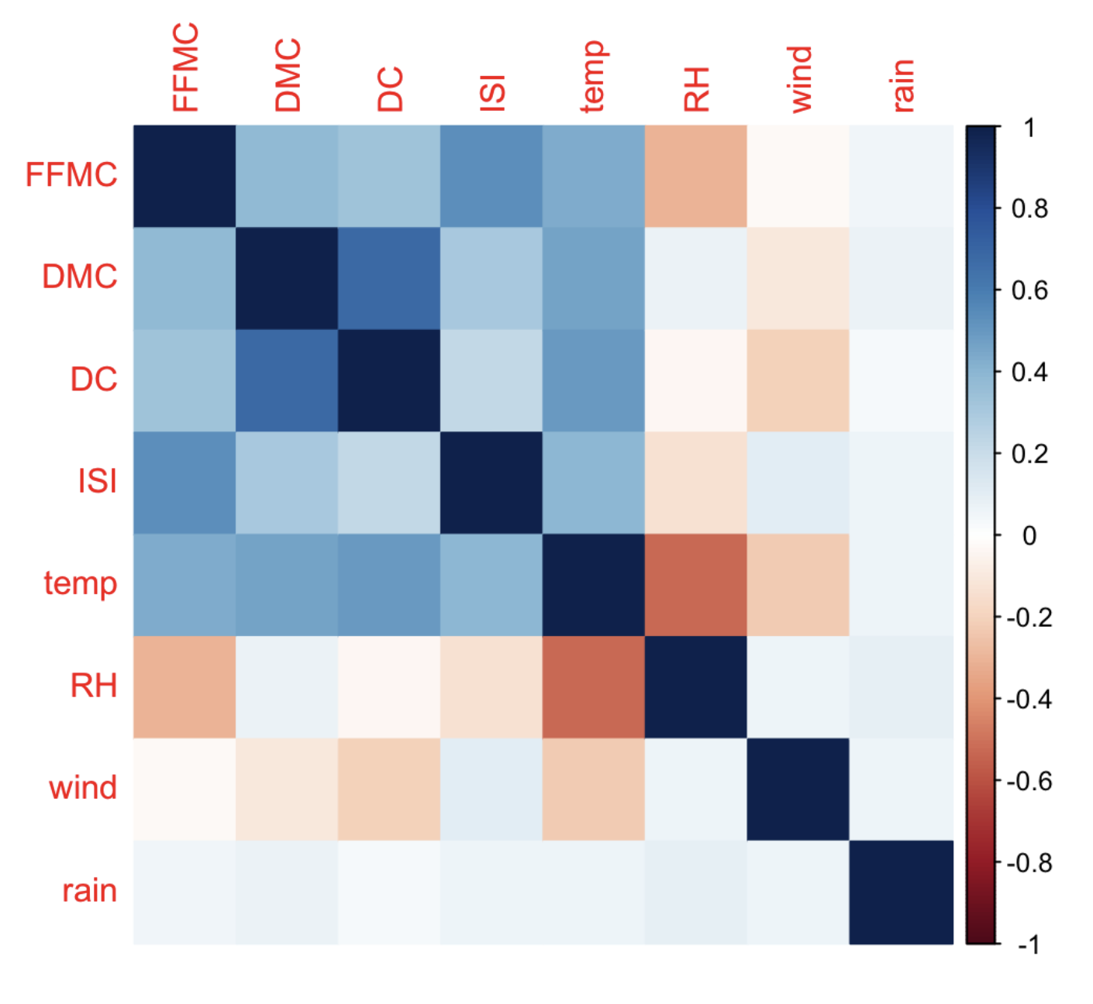
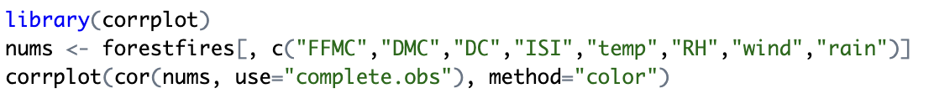
Correlation Heatmap of Weather Indices
Instantly Highlights Strong Relationships
Positive vs. Negative Correlation
Strength of Association
“Which fuel‐moisture indices co‐vary most?” or “Does wind speed correlate more with fire spread index (ISI) than rain does?
Temp correlates positively with FFMC/DMC/DC/ISI (r ≈ 0.3–0.6), reflecting that hotter days tend to dry out fine and deep fuels and speed spread.
Temp vs. RH shows a strong negative correlation (r ≈ –0.6), typical of hot, dry conditions.
RH correlates negatively with FFMC, DMC, DC, ISI (r ≈ –0.2 to –0.4), reinforcing that moister air suppresses fine-fuel dryness and spread potential.

Slide 12
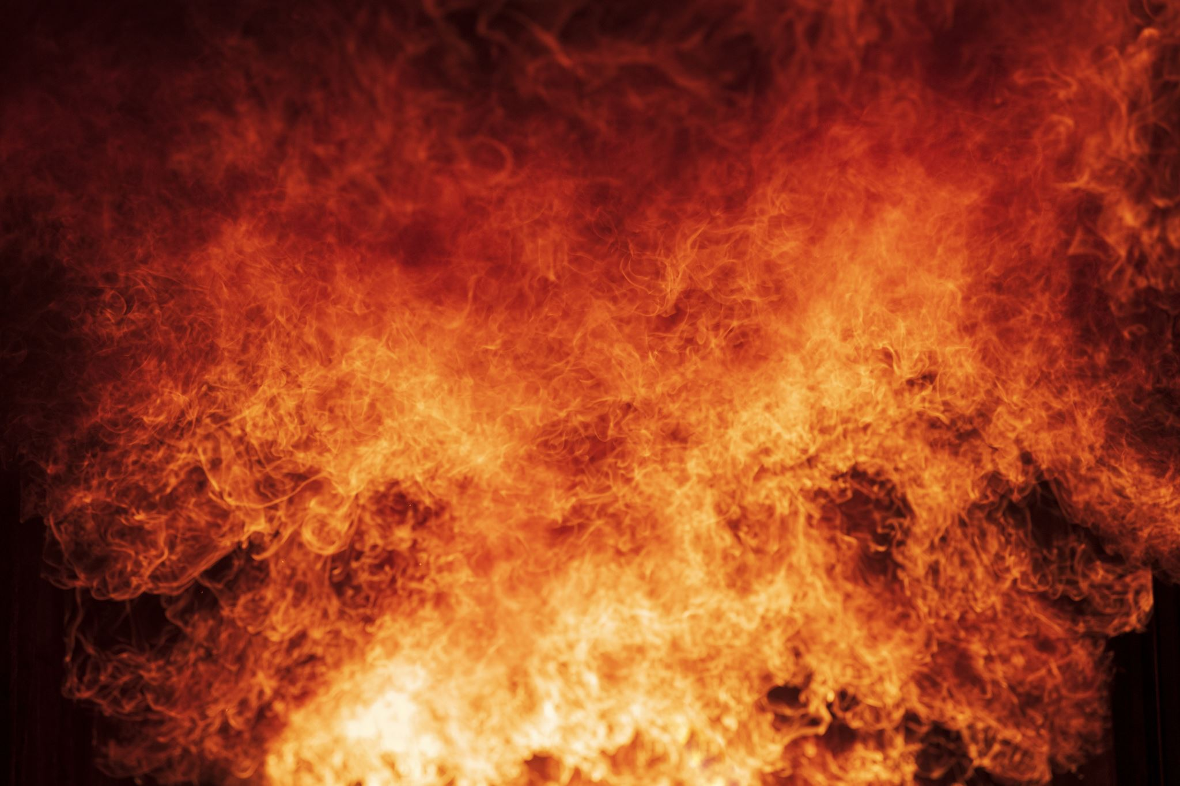
Conclusions
More preventive measures and resource allocations should be done especially in the months of August and September where there is a high forest fire count.
None of the factors in the dataset were shown to have a significant effect on burn area with the methods used
Surprising, because the factors should have an effect on burn area
Zero‐inflation & skewness: Nearly half the records (247 of 517) have area = 0 (fires < 100 m² logged as zero), creating a heavy zero-inflation that reduces the statistical power to distinguish mean differences across months.
Unequal & small sample sizes per month: Fire counts vary widely (e.g. far fewer events in winter months), leading to unbalanced groups and low sensitivity in ANOVA.
Advanced methods should be used for data collection as early-2000s area data were often manually logged or derived from coarse satellite/ground maps, introducing imprecision
The dataset is difficult to work with
Maybe it is not large enough (need data from more years)

Slide 13
References
UCI Machine Learning Repository. (2016). Uci.edu. https://archive.ics.uci.edu/dataset/162/forest+fires
‌Vasco Cotovio. (2024, October 8). How the source of your tissues and toilet paper is fueling wildfires thousands of miles away. CNN. https://www.cnn.com/2024/10/08/climate/portugal-fires-eucalyptus-paper/index.html

